Slide 1
Open IIT Data Analytics
Data Warriors

Slide 2
Contents
Problem Statement
Dataset
Features
Trends
Plots & Visualisation
Models
Results
Insights
References

Slide 3
Problem Statement
Design and implement a machine learning model that predicts tourist arrivals to a specific destination using Internet search index data as a key input. The goal of this competition is to develop an accurate and robust predictive model that can assist tourism authorities and businesses in forecasting tourist arrivals, thereby enabling better resource allocation, marketing strategies, and overall destination management.

Slide 4
Dataset
Collected The Monthly samples for the following cities
Shimla
Kerala
Bifurcated the monthly data in to weekly data for prediction

Slide 5
Features
Domestic visitors
Foreigner visitors
Google trends
Flights Booking
Trains Booking
Buses
Cars
Weather
Temperature
Relative Humidity
Snowfall
Rain
Windspeed

Slide 6
Trends

Slide 7
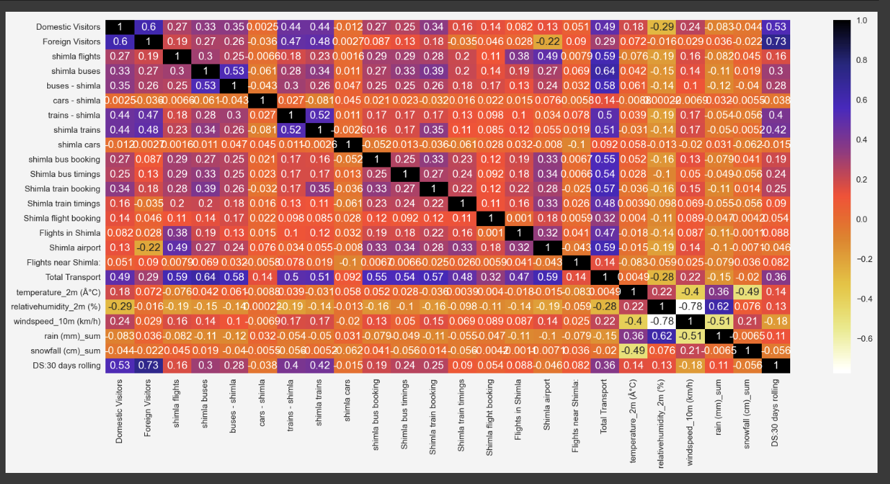
Heat map of Shimla

Slide 8
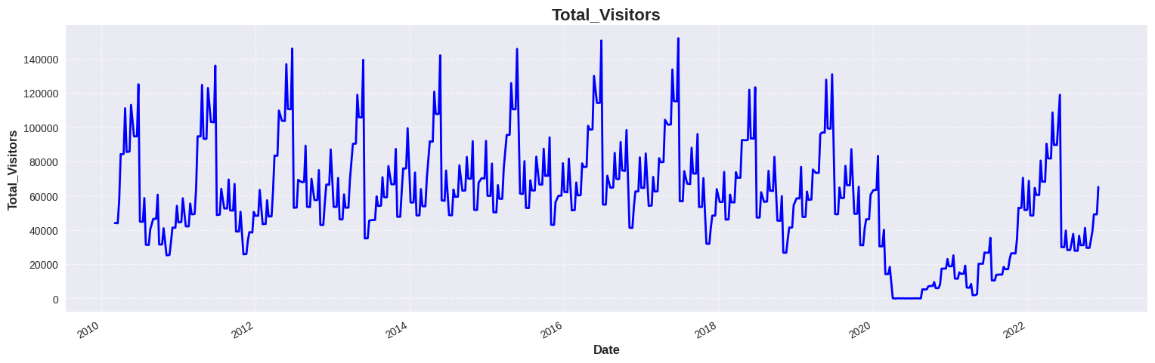
Total Visitors

Slide 9
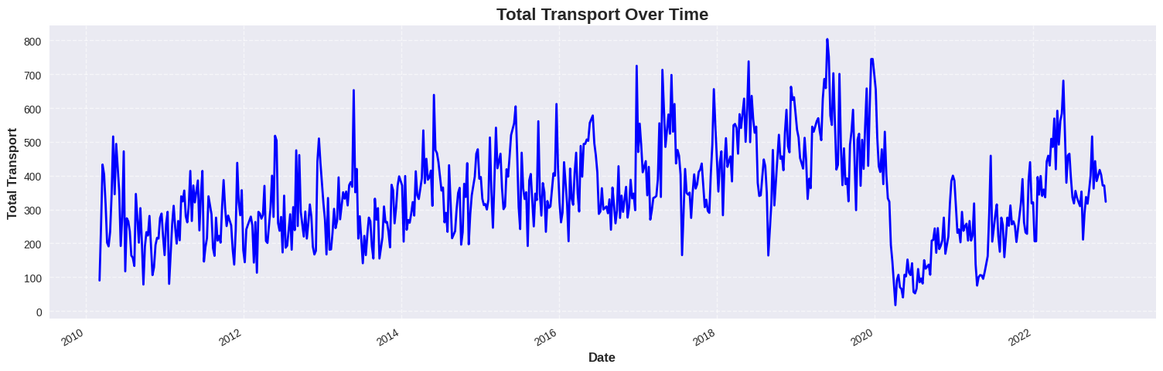
Total Transport

Slide 10
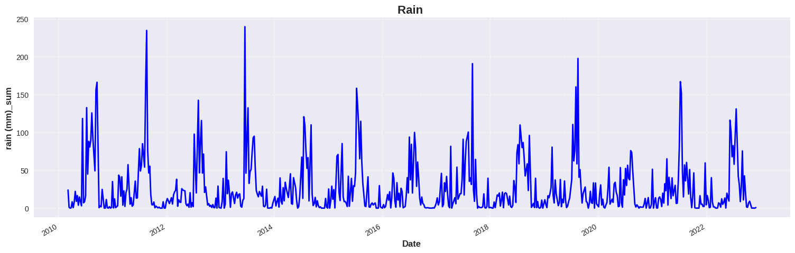
Rainfall

Slide 11
Outliers

Slide 12
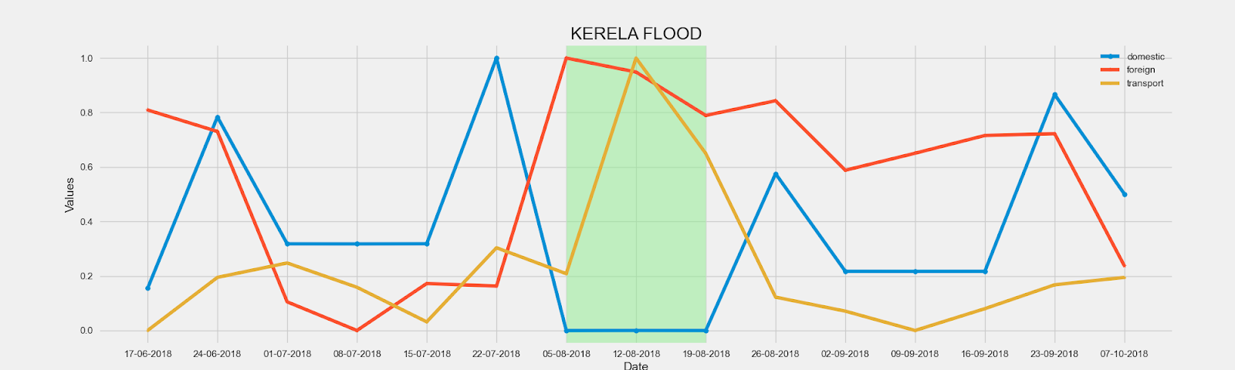
Kerala Flood

Slide 13
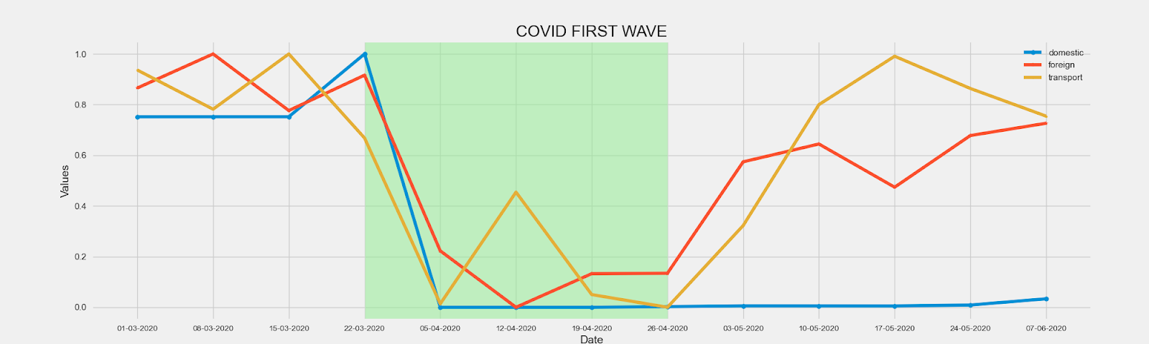
Covid-19

Slide 14
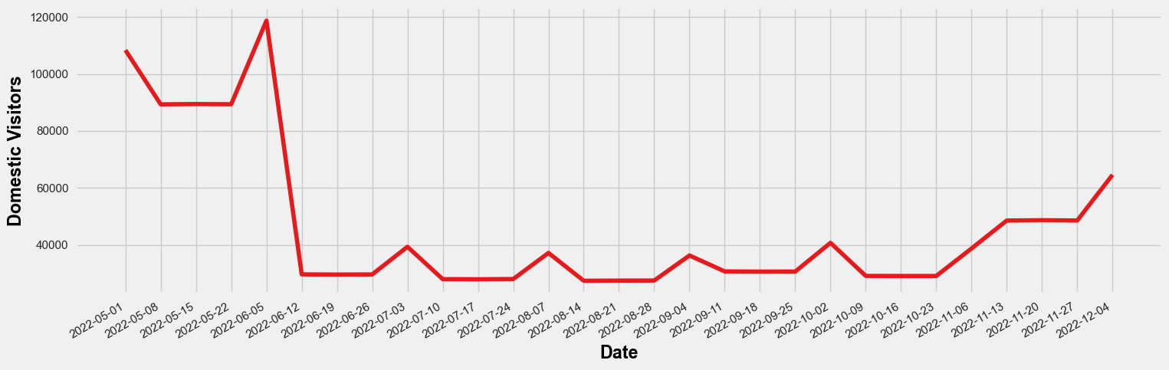
Shimla Cloud Burst

Slide 15
Models

Slide 16
Trained Models
The models are:
SARIMAX -(rmse-0.0131)
LSTM-(rmse-0.51)
XG Boost - (rmse-0.588)
ARIMA - (rmse-0.1)

Slide 17
SARIMAX
SARIMAX, or Seasonal Autoregressive Integrated Moving Average with Exogenous Regressors, is a statistical method used for time series forecasting. It extends the ARIMA model by incorporating exogenous variables and accounting for seasonal components.

Slide 18
LSTM
LSTM, or Long Short-Term Memory, is a type of recurrent neural network (RNN) capable of learning long-term dependencies. It addresses the vanishing gradient problem, allowing for the effective processing of sequential data.

Slide 19
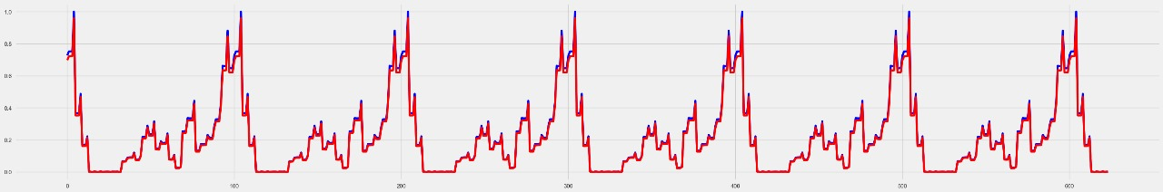
Results & Accuracy
SARIMAX -(rmse-0.0131)
ARIMA - (rmse-0.1)
LSTM-(rmse-0.51)
XG Boost - (rmse-0.588)
Best Model: SARIMAX(Seasonal AutoRegressive Integrated Moving Average with Exogenous Variables):

Slide 20
Insights
Drop in total tourists due to COVID-19 in 2020, 2021, 2022
Water Crisis in Shimla during 2015 and 2017
Not much effect on total transport due to water crisis
Kerala flood in 2018
Bus transport is important for Kerala with correlation 0.63

Slide 21
References
Shimla Weather
https://open-meteo.com/en/docs/historical-weather-api
Shimla Tourism
https://himachaltourism.gov.in/types/district/
Kerala Weather
https://open-meteo.com/en/docs/historical-weather-api
Kerala Tourism
https://www.keralatourism.org/touriststatistics/
Google Trends
https://trends.google.com/trends/

Slide 22
Thank you

